Slide 1
Lend ngClub
A Peer-to-Peer Loan Analysis
Team 1
Jonathan Schild
Medhasweta Sen
Brian Gulko
Bharat Premnath
The George Washington University
December 12, 2022

Slide 2


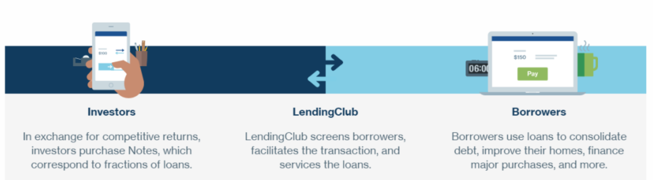
What is LendingClub
Source: https://www.moneysmylife.com/lendingclub-review/
Notes:
Peer-to-peer (P2P) was a phenomenon less than ten years ago, exploding in popularity by offering a break from traditional banking. Individuals flocked to the alternative credit markets as alternative sources of funding and for new opportunities to finance their small business ventures.
Although direct P2P lending has undergone changes over recent years, it remains a viable option for borrowers and investors. We are seeking to understand the factors that might have signalled risky loans or borrowing practices and could be consumed or applied by prospective borrowers, lenders, and/or investors considering participating in direct P2P.

Slide 3
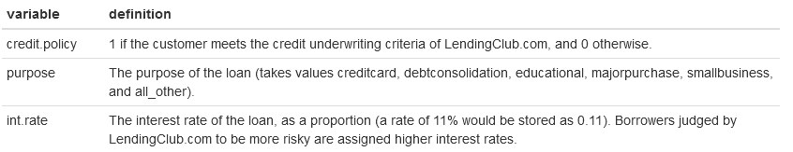
Our Data
9,578 observations
14 variables
11 numeric
2 logical
1 factor with 7 levels
.
.
.
.
.
https://www.kaggle.com/datasets/urstrulyvikas/lending-club-loan-data-analysis
Notes:
Our dataset contains over 9,500 observations of loan data from LendingClub, the largest online platform for direct P2P lending.¹ We believe that the timeframe of 2007 to 2015 provides the most relevant data for prospective individual investors today, particularly because it is unlikely to include a significant number of large institutional lenders.

Slide 4
Added Variables
Natural log of revolving balance (log.revol.bal)
Logical based on if revol.bal is greater than 0 (has.revol.bal)
Logical based on if delinq.2yrs is greater than 0 (has.delinq.2yrs)
Logical based on if pub.rec is greater than 0 (has.pub.rec)
https://www.kaggle.com/datasets/urstrulyvikas/lending-club-loan-data-analysis

Slide 5
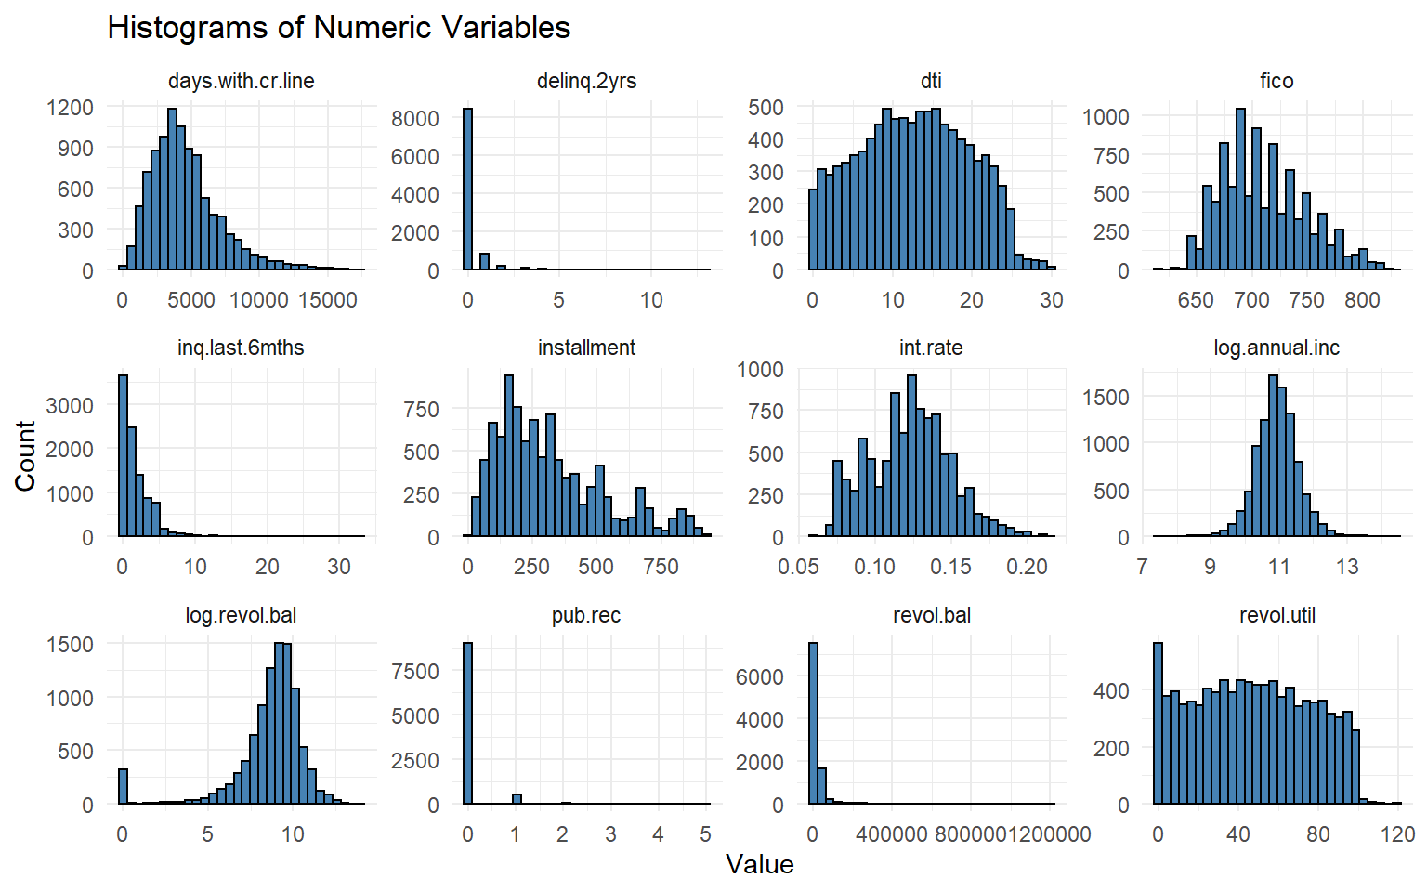
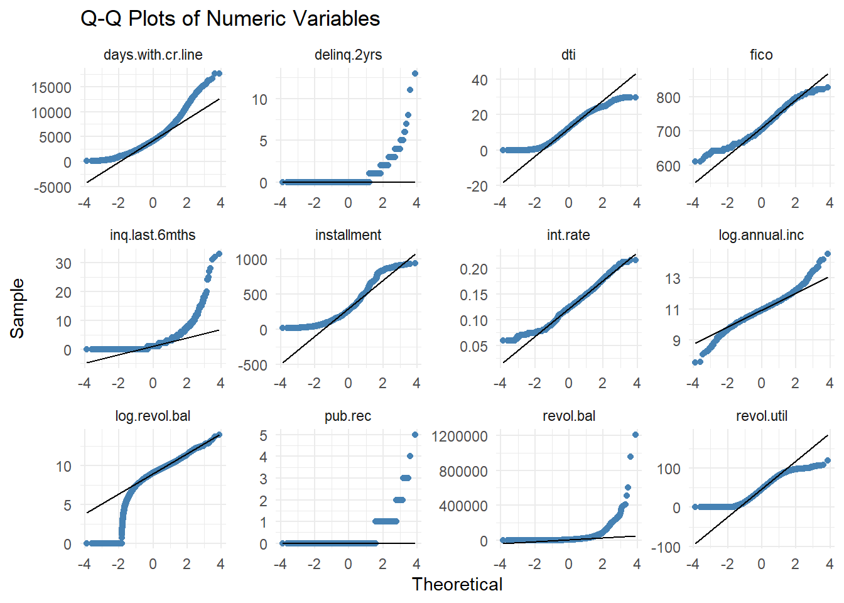
EDA Review

Slide 6
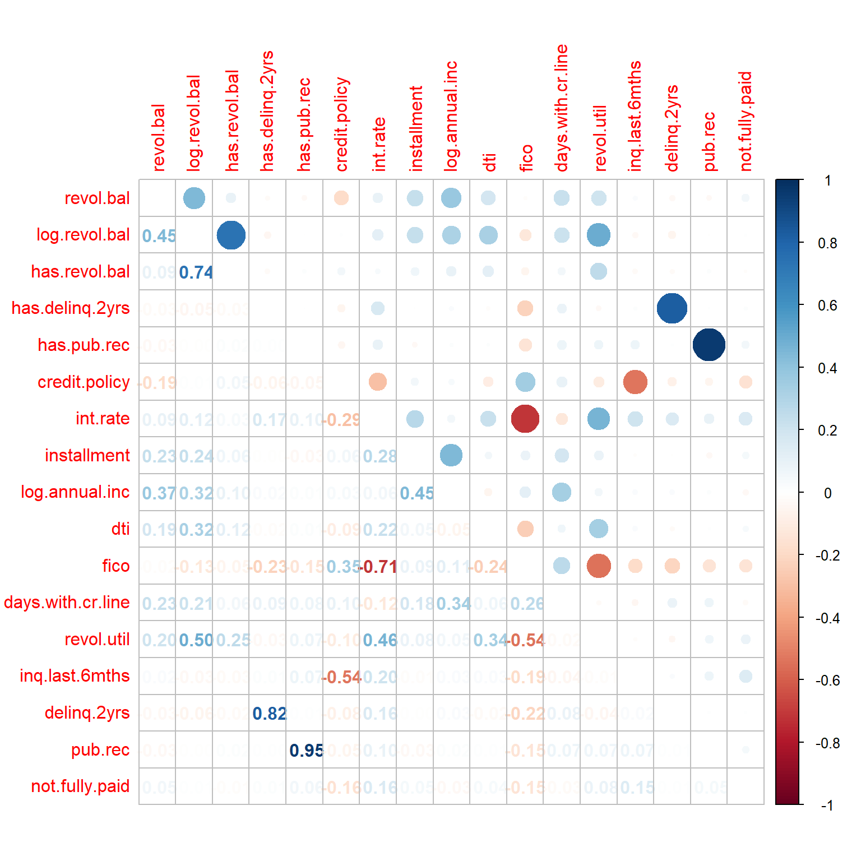
EDA – Correlation Plot

Slide 7
SMART Question & Models Chosen
SMART Questions
What variable or variables, if any, have an impact on if the person meets the credit underwriting criteria?
What variable or variables, if any, have an impact on if the person fully repays the loan?
Do borrowers who meet the credit underwriting criteria have a lower chance of not fully repaying the loan? If so, how big is the difference?
Models
5 Simple Linear Regressions
3 Multiple Regressions
2 Logistic Regressions
2 Classification Trees

Slide 8
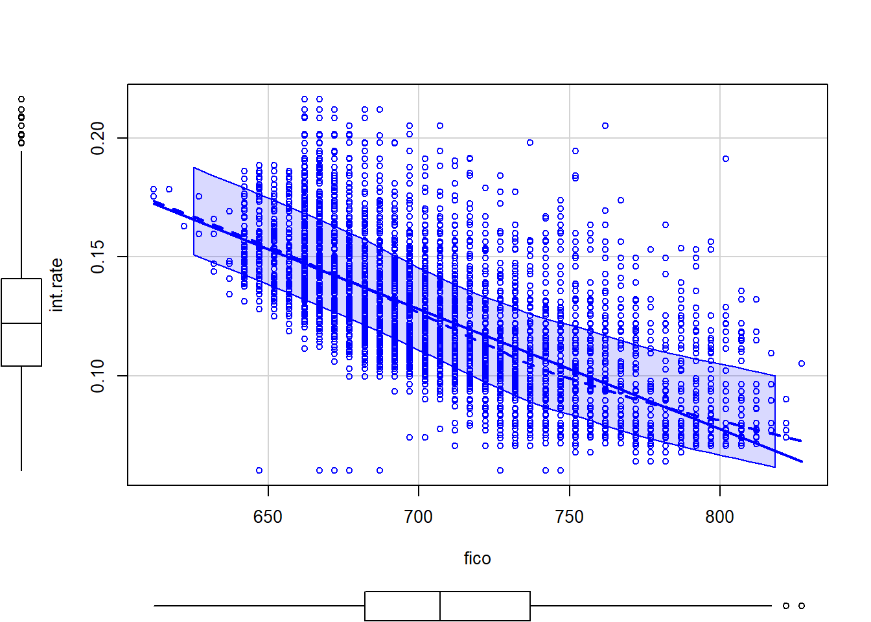
Simple Linear Regression – 1 of 5
R² = 0.51
Pr < 2e-16

Slide 9
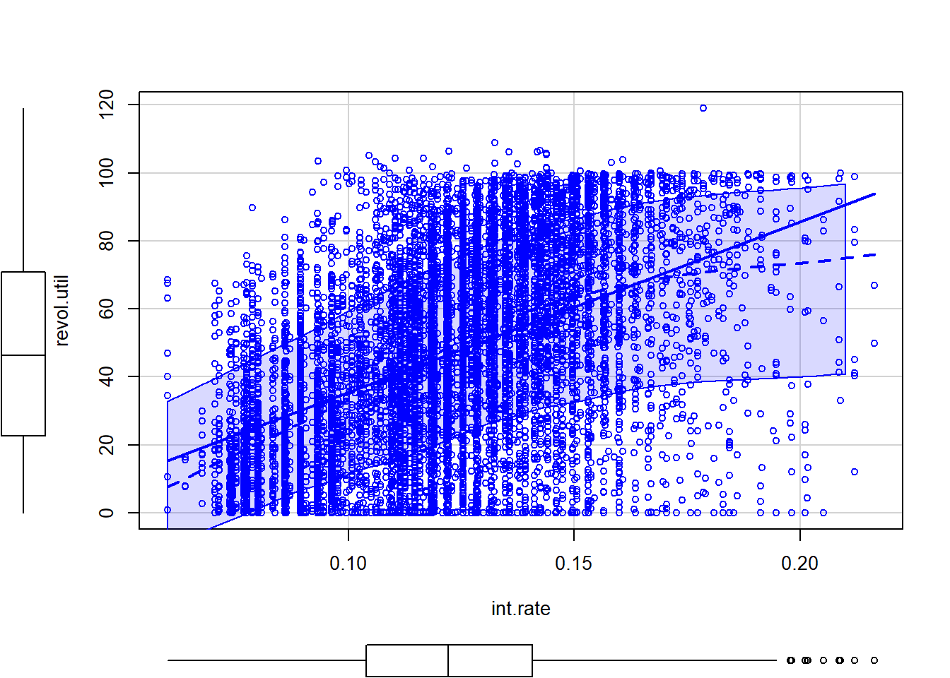
Simple Linear Regression – 2 of 5
R² = 0.22
Pr < 2e-16

Slide 10
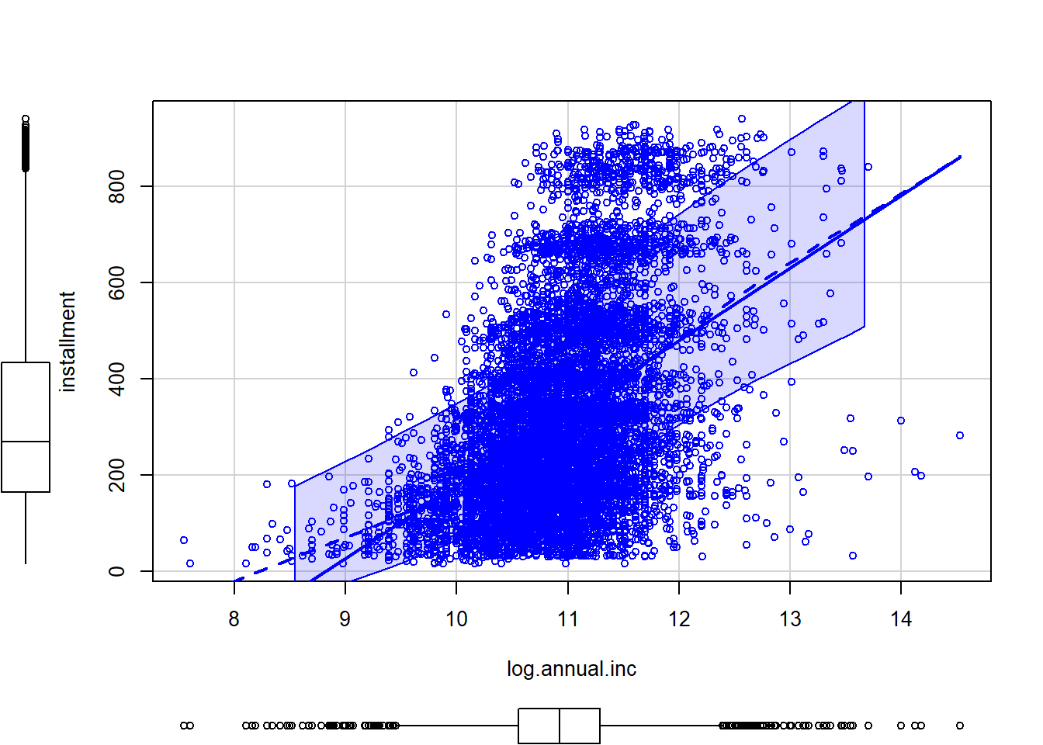
Simple Linear Regression – 3 of 5
R² = 0.20
Pr < 2e-16

Slide 11
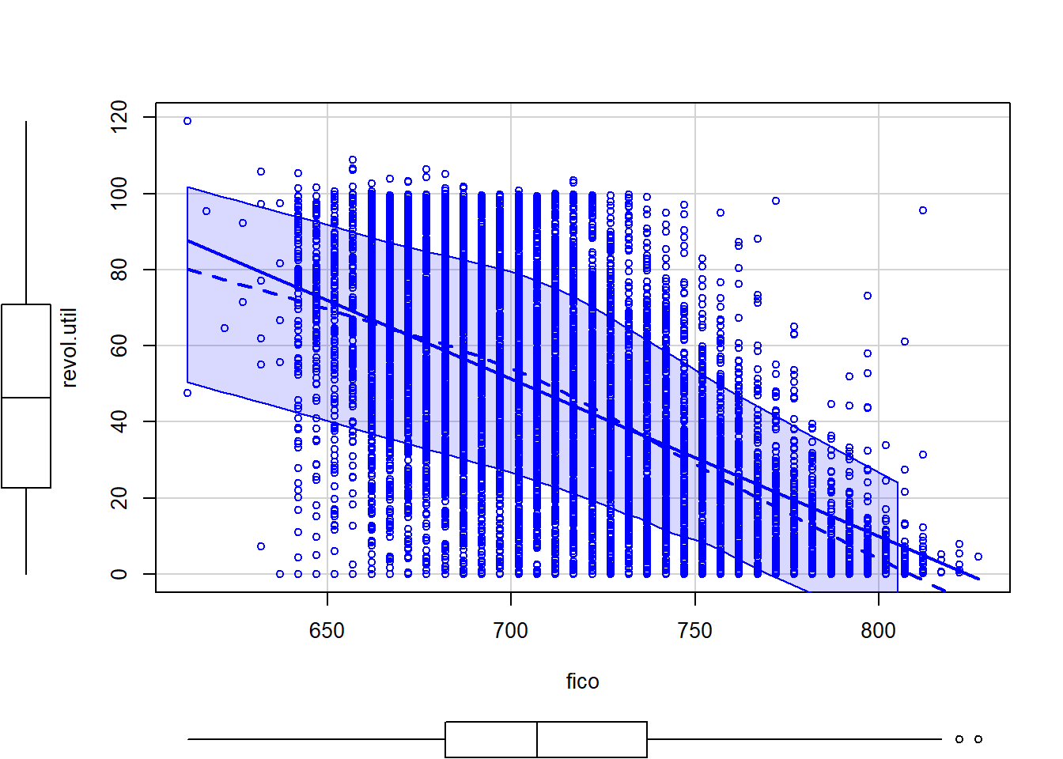
Simple Linear Regression – 4 of 5
R² = 0.29
Pr < 2e-16

Slide 12
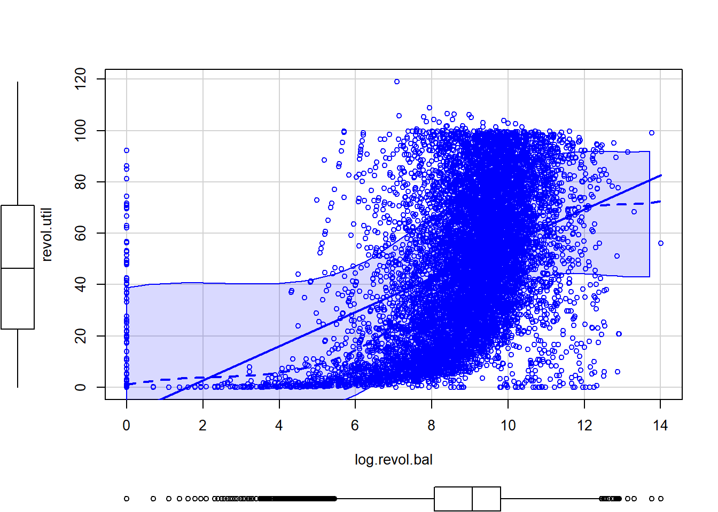
Simple Linear Regression – 5 of 5
R² = 0.25
Pr < 2e-16

Slide 13
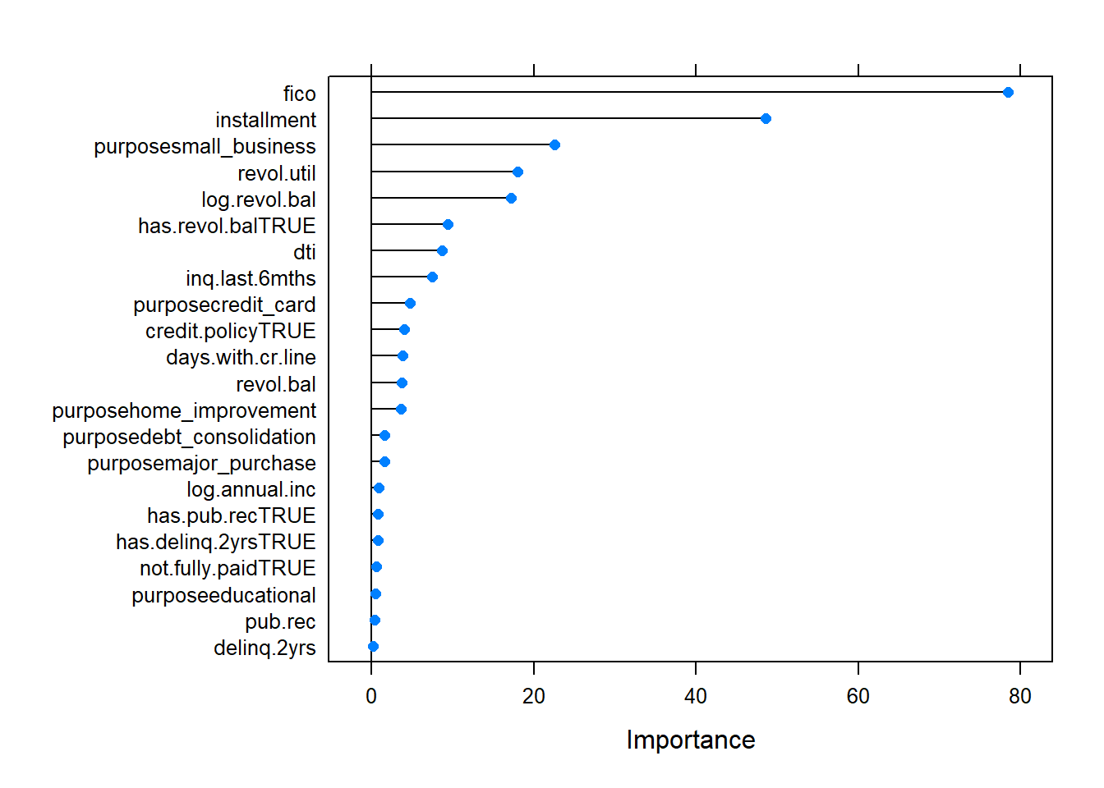
Multiple Linear Regression – Int Rate

Slide 14
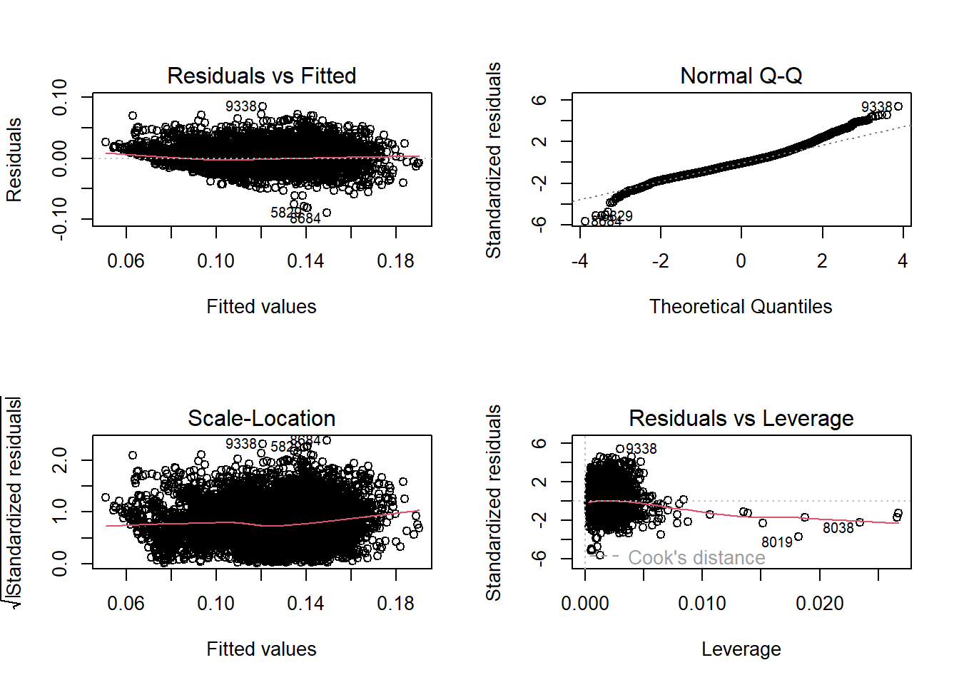
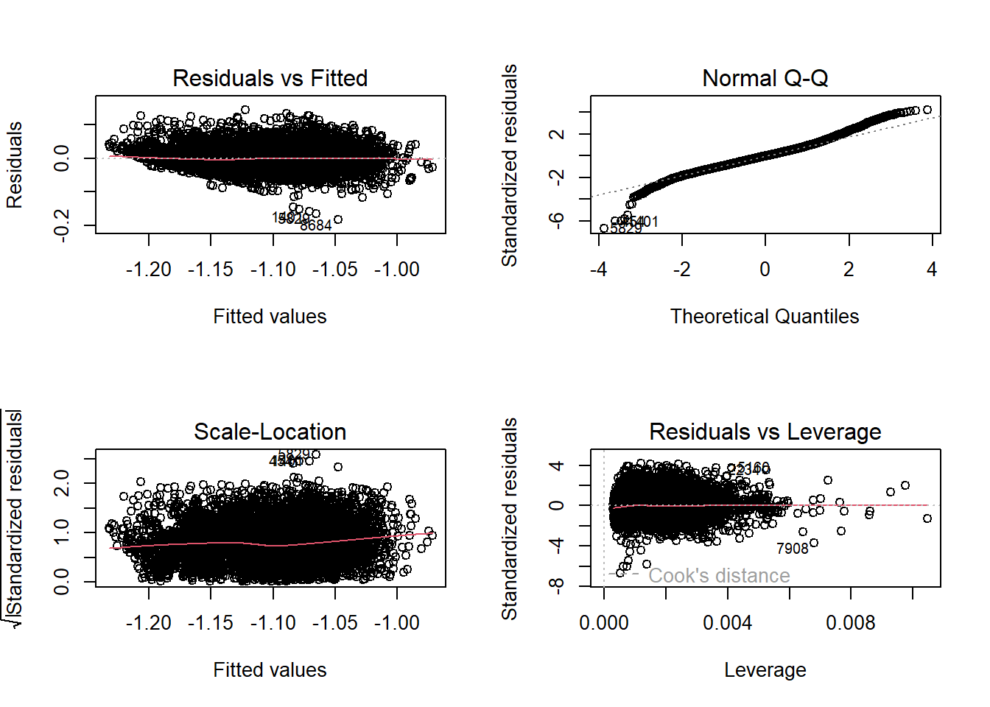
Multiple Linear Regression – Int Rate

Slide 15
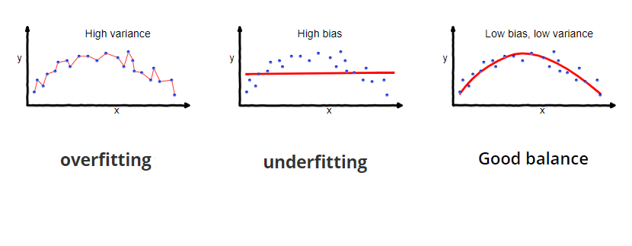
Lasso Regression
LASSO (Least Absolute Shrinkage and Selection Operator) is a modified version of OLS (Ordinary Least Squares) that involves optimization of cost function subject to a constraint.
The two uses of LASSO Regression :
Avoid Overfitting
Eliminate the less important features

Slide 16
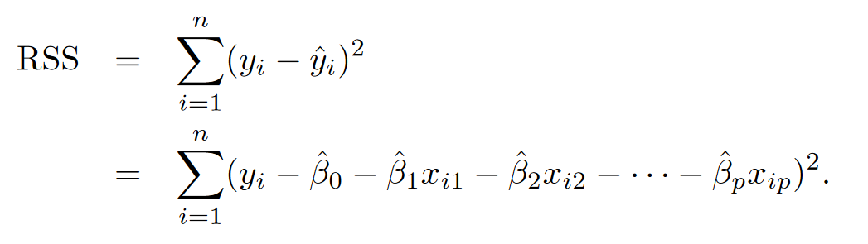
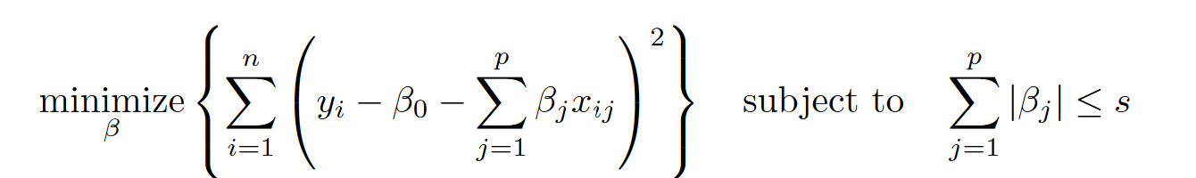
Lasso Regression
The cost function of OLS
The cost function of LASSO
The ultimate aim of optimization of cost function is to obtain the co-efficients (β) that give minimum residual errors.

Slide 17
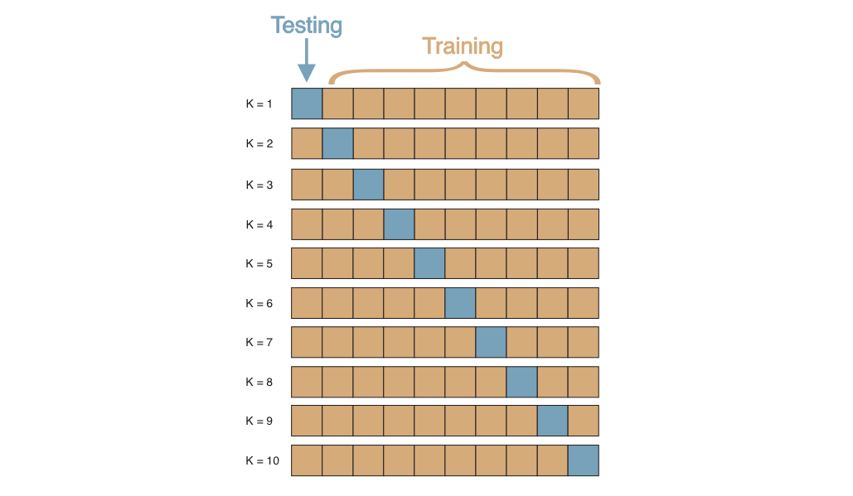
Lasso Regression
The 10 fold cross validation
Cross Validation is performed to evaluate the model when it encounters new data.
The dataset is split into 10 different parts and each of the part is used for testing while the remaining parts are used for training.
The residual errors of the test data is known as cross validation error.

Slide 18
Lasso Regression
The solver cv.glmnet() of glmnet library was used to run the lasso regression to know the important features that predict the interest rate.
The solver by default performs a 10 fold cross validation and selects a sequence of λ values.
The best λ is selected based on the smallest cross validation error.
For our model, the 70% of the data was reserved for training and remaining 30% of the data for testing.
The below table shows the metrics of LASSO model for the 30% test data.
Best Lambda | 4.511766e-05
MSE | 0.0002707
R-squared | 0.64

Slide 19
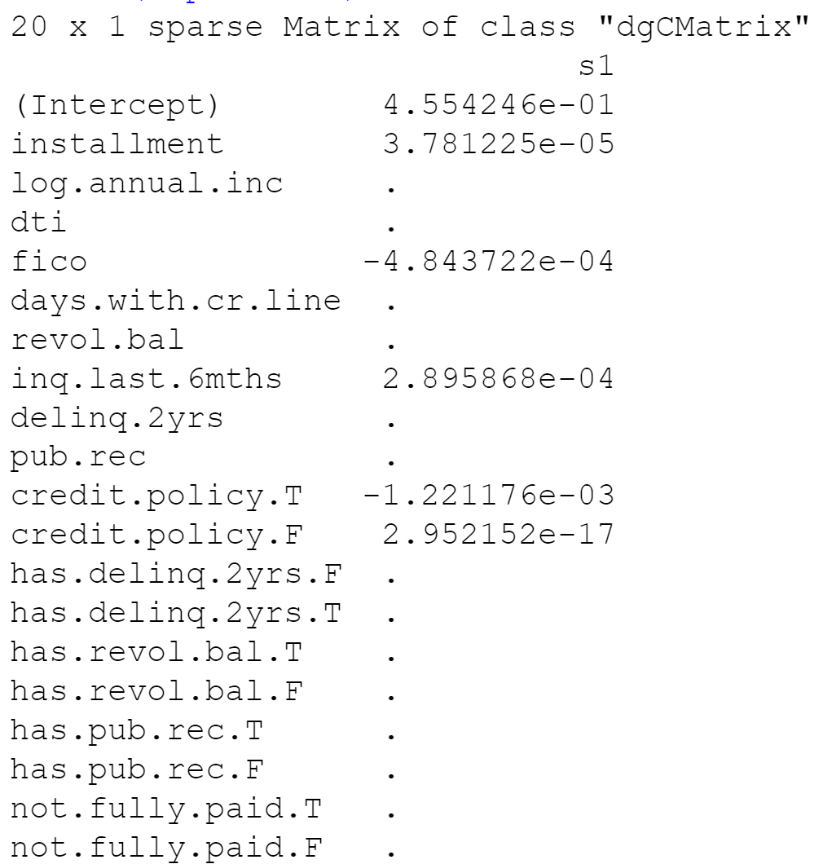
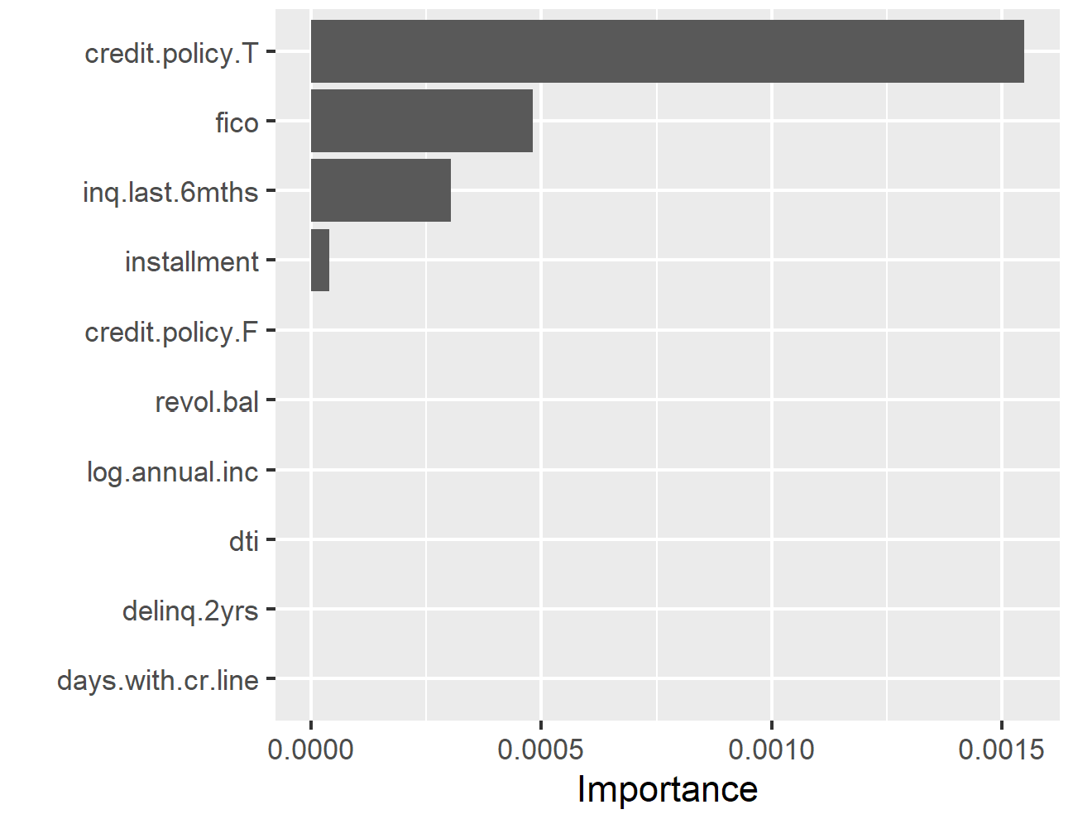
Lasso Regression
The shrunken co-efficients values and feature importance score obtained from LASSO model.

Slide 20
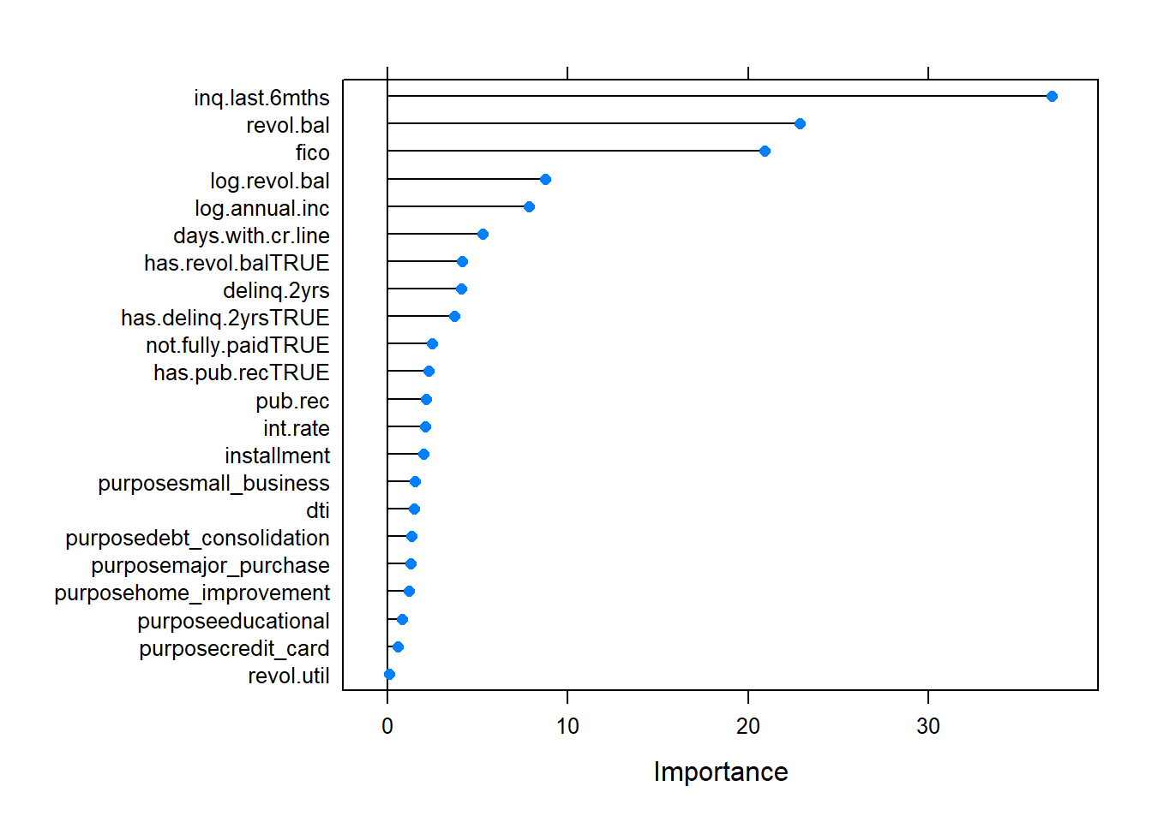
Logistic Regression – Credit Policy

Slide 21
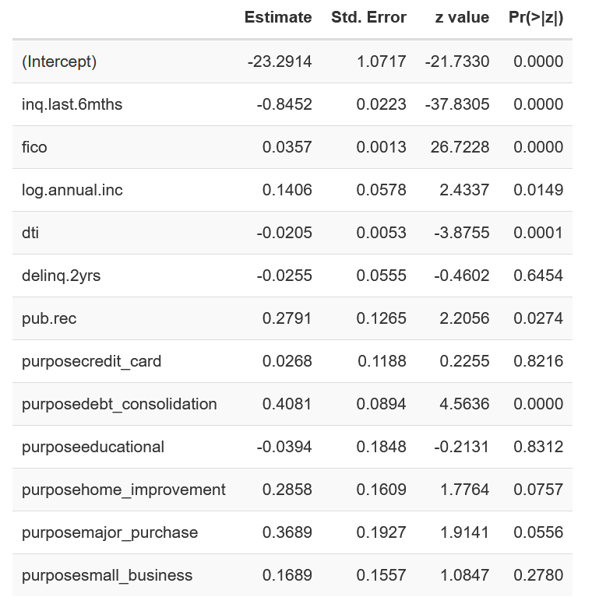
Logistic Regression – Credit Policy

Slide 22
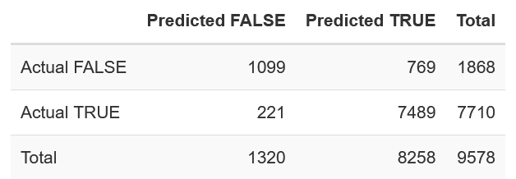
Logistic Regression – Credit Policy

Slide 23
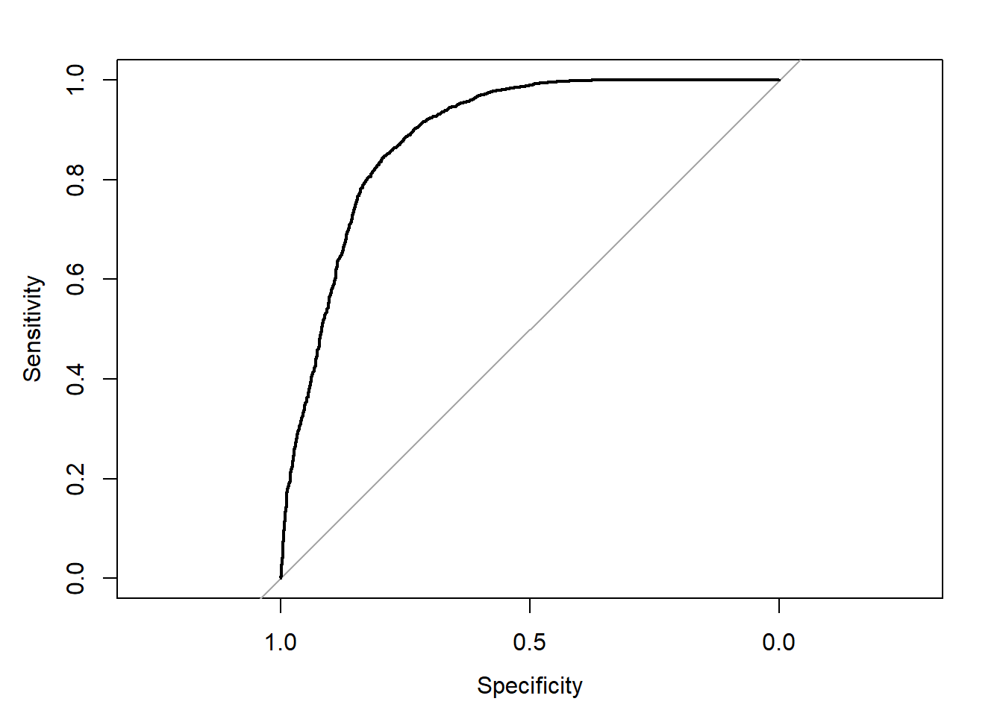
Logistic Regression – Credit Policy

Slide 24
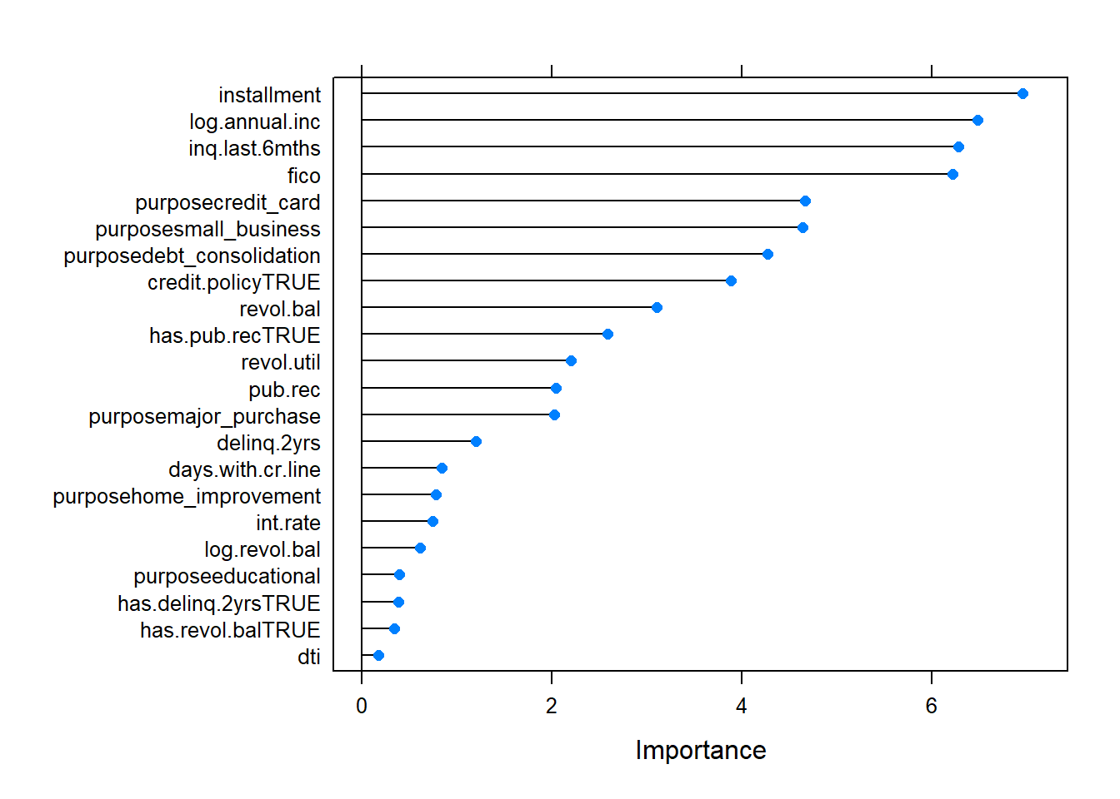
Logistic Regression – Not Fully Paid

Slide 25
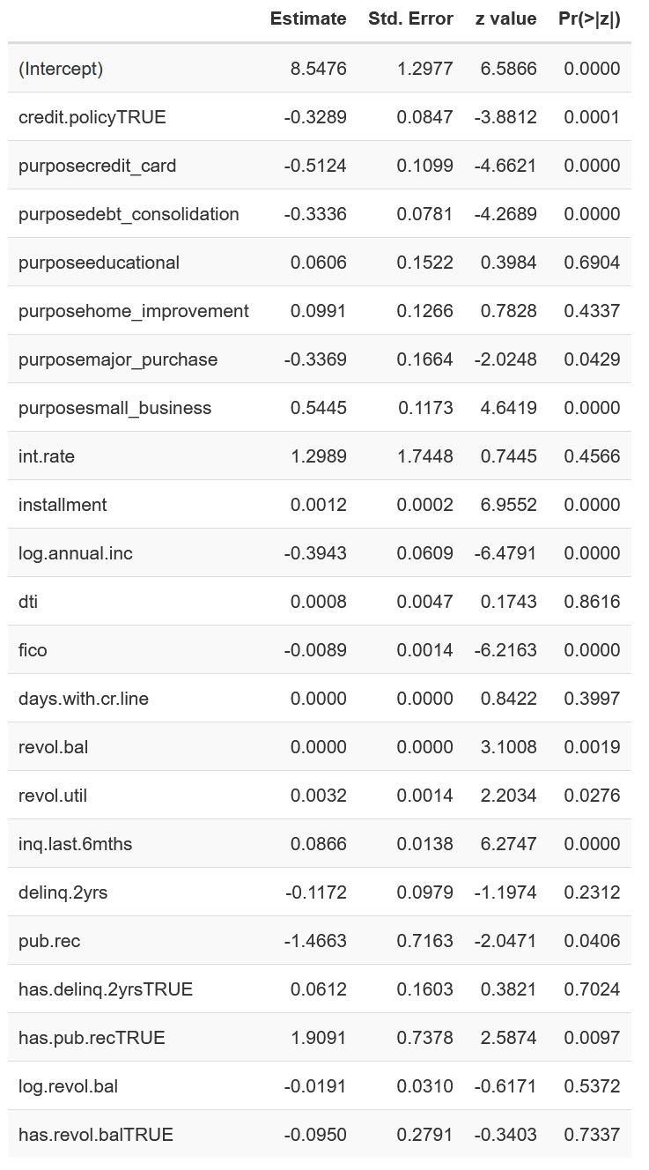
Logistic Regression – Not Fully Paid

Slide 26
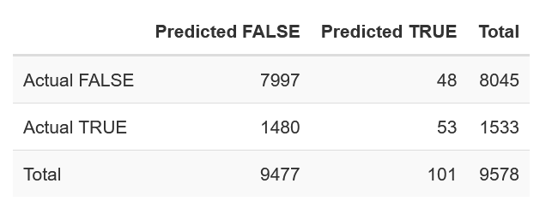
Logistic Regression – Not Fully Paid

Slide 27
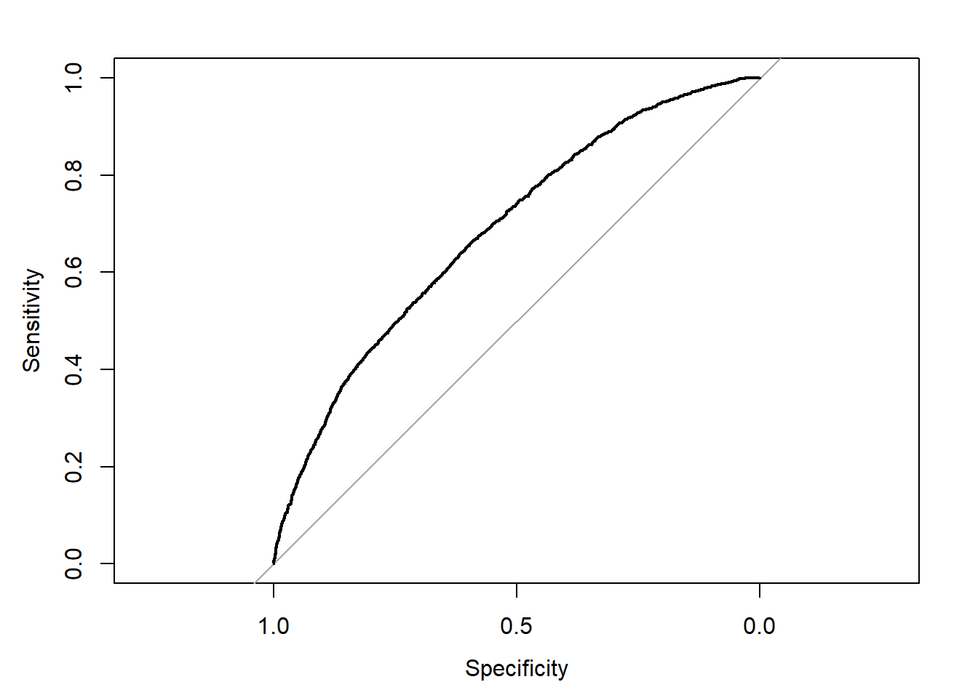
Logistic Regression – Not Fully Paid

Slide 28
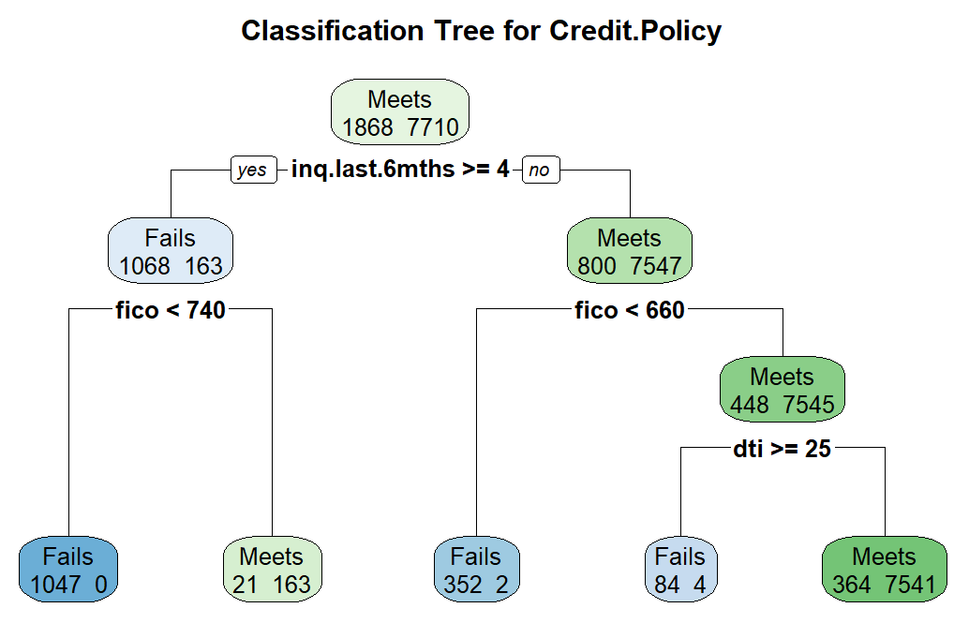
Classification Tree – Credit Policy
Tree
Three variables
4 splits
Confusion Matrix
Specificity: 0.999
Recall/Sensitivity: 0.794
Precision: 0.996
AUC: 0.900
Kappa: 0.859
Predictions vs Actual
1483 predicted fails vs 1868 actual fails
7704 predicted meets vs 7710 actual meets
Notes:
Intro:
So we wanted to do a classification tree for two of our factor variables to get an understanding of the some of the rules and thresholds underlying our dataset, and test whether this method would prove beneficial for future application
Both variables (credit policy and not fully paid) are binary in nature.
Explain tree:
So we did credit policy first. You can see that our tree first split the data by number of inquires in the last 6 months, with the threshold here being greater than or equal to 4. Looking left, and unsurprisingly, loans with four or more inquiries, require a high FICO score to meet the credit policy, with those lower than 740 all failing to meet the credit policy.
Moving to the right side of the tree we can see the difference in the FICO score requirements. Here, for borrowers with less than 4 inquiries, a FICO score of only 660 appears to be a general threshold that separates loans that might meet the policy from those who do not. This was an interesting point because these two FICO thresholds tells us that if a loan applicant has a FICO score lower than 660, then they will probably fail to meet the credit policy, regardless of the number of inquiries they had in the past 6 months.
Moving further to the bottom right of the tree, we can see that debt-to-income ratios begin to come into play. Loan applicants with less than 4 inquiries and a FICO score better than 660, a debt-to-income ratio of 25 distinguishes between those who generally did not meet the credit policy and those who still might. This was less meaningful to us because those who have 25 times more debt than their income level would not be expected to meet a rational credit policy.
So overall, was that loan applicants should have fewer than 4 inquiries from other creditors within the past 6 months, have a reasonable FICO score higher than 660, and should not have an exorbitant amount of debt if they want to anticipate meeting the credit policy.
Confusion Matrix:
We than wanted to check some of the statistics associated with our tree to gauge its reliability and predictability. We found most of them, if not all of them, to be promising.
The sensitivity and specificity values indicate the test can fairly reliably detect loans that meet and fail to meet the credit policy. We can also tell that we have a favorable, high arching, ROC curve after looking at the these values along with with the AUC.
The high precision indicates the tree is very good identifying true positives, in that 99.6% of its predicted fails were right.
The high kappa value of .859 suggests there is a high degree of agreement between the predictions and the actual values.
At the end here, we just sort of contextualize some of the stats we just discussed. You can see our tree predicted 1483 loans to fail to meet the credit policy while 1868 actually did. And it predicted 7704 loans to meet the credit policy while 7710 actually did.
IF ASKED: these predicted amounts exclude false positives and false negatives.
The true negatives are those who met the credit policy
The true positives are those who failed to meet the credit policy
ADMIN:
Sensitivity (true positive rate; y-axis) refers to the probability of a positive test, conditioned on truly being positive.
Specificity (true negative rate; x-axis) refers to the probability of a negative test, conditioned on truly being negative.
Kappa coefficient measures the agreement between classification and truth values. A kappa value of 1 represents perfect agreement, while a value of 0 represents no agreement.
credit.policy: 1 if the customer meets the credit underwriting criteria of LendingClub.com, and 0 otherwise.
inq.last.6mths: The borrower's number of inquiries by creditors in the last 6 months.
fico: The FICO credit score of the borrower.
dti: The debt-to-income ratio of the borrower (amount of debt divided by annual income).
credit.policy: 1 if the customer meets the credit underwriting criteria of LendingClub.com, and 0 otherwise.
purpose: The purpose of the loan (takes values "credit_card", "debt_consolidation", "educational", "major_purchase", "small_business", and "all_other").
int.rate: The interest rate of the loan, as a proportion (a rate of 11% would be stored as 0.11). Borrowers judged by LendingClub.com to be more risky are assigned higher interest rates.
installment: The monthly installments owed by the borrower if the loan is funded.
log.annual.inc: The natural log of the self-reported annual income of the borrower.
dti: The debt-to-income ratio of the borrower (amount of debt divided by annual income).
fico: The FICO credit score of the borrower.
days.with.cr.line: The number of days the borrower has had a credit line.
revol.bal: The borrower's revolving balance (amount unpaid at the end of the credit card billing cycle).
revol.util: The borrower's revolving line utilization rate (the amount of the credit line used relative to total credit available).
inq.last.6mths: The borrower's number of inquiries by creditors in the last 6 months.
delinq.2yrs: The number of times the borrower had been 30+ days past due on a payment in the past 2 years.
pub.rec: The borrower's number of derogatory public records (bankruptcy filings, tax liens, or judgments).

Slide 29
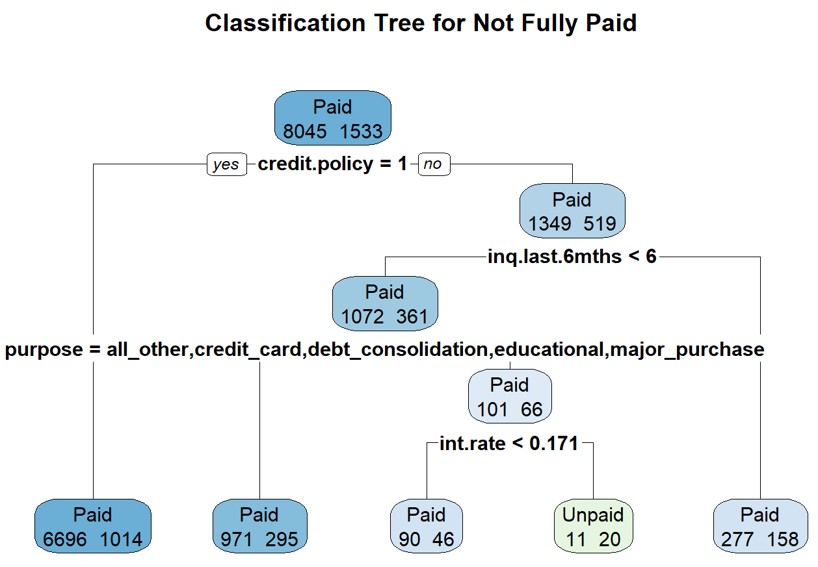
Classification Tree – Not Fully Paid
Tree
Complexity Parameter forced to .001
Four variables
4 splits
Confusion Matrix
Specificity: 0.013
Recall/Sensitivity: 0.999
Precision: 0.842
AUC: 0.59
Kappa: 0.019
Predictions vs Actual
8034 predicted paids vs 8045 actual paids
20 predicted unpaids vs 1533 actual unpaids
Notes:
Intro:
So then we wanted to a similar tree for our not fully paid variable.
Initially, the classification tree revealed in no chosen variables and only the single root node, a kappa value of 0, and a ROC curve that fit directly on the random classifier line. We interpreted this as a strong indicator that a classification tree would not be useful for the not fully paid variable.
To confirm or corroborate that indicator, we overrode the default complexity parameter in the rPart function and lowered it from .01 to .001. By reducing that value in the R code, we reduce the minimum improvement amount that is required at each node for a split to occur during the tree’s configuration. In other word, we essentially lowered the restriction on how and when the tree is constructed. As you can probably imagine, this could yield a less meaningful tree.
Explain tree:
By reducing the complexity parameter to .001, we were able to force the classification tree to split more; in this case by the ‘credit.policy`, `inq.last.6mths`, `int.rate`, and `purpose`. Looking at it though, and in line with our expectations, we can see that it is not very informative.
The majority of loans that met the credit.policy, paid the loan, which we would generally expect.
We can also see that that those loans that did not meet the credit policy, had higher a number of inquiries in the last 6 months, and higher interest rates, would probably more susceptible of going Unpaid; this is also what we would generally expect to see.
IF ASKED: we do not consider the distinction between loan purpose to be meaningful because of the number of Unpaid values among other leaf nodes and their proportion to the Paid values.
Confusion Matrix:
So we generally have less faith in this tree already, but we wanted to check out the confusion matrix stats as well to guage its reliability and predictability.
We immediately see the extremely low specificity value, which indicates the tree was terrible at detecting those that went unpaid. That with the low AUC indicates a less than promising ROC curve.
Lastly, the extremely low Kappa statistic of .019, suggests there is nearly no agreement between the predictive model and the actual data.
So in summary, we determined that the classification tree for credit policy was reliable and that we could apply it going forward, while the tree for not full paid proved to be unreliable and not useful for future application.
ADMIN:
Sensitivity (true positive rate; y-axis) refers to the probability of a positive test, conditioned on truly being positive.
Specificity (true negative rate; x-axis) refers to the probability of a negative test, conditioned on truly being negative.
Kappa coefficient measures the agreement between classification and truth values. A kappa value of 1 represents perfect agreement, while a value of 0 represents no agreement.
credit.policy: 1 if the customer meets the credit underwriting criteria of LendingClub.com, and 0 otherwise.
inq.last.6mths: The borrower's number of inquiries by creditors in the last 6 months.
purpose: The purpose of the loan (takes values "credit_card", "debt_consolidation", "educational", "major_purchase", "small_business", and "all_other").
int.rate: The interest rate of the loan, as a proportion (a rate of 11% would be stored as 0.11). Borrowers judged by LendingClub.com to be more risky are assigned higher interest rates.

Slide 30
Model Application
Actual Credit Policy
Credit Policy | Percent Not Fully Paid
Fails | 27.8%
Meets | 13.2%
Decision Tree Predicted Credit Policy
Credit Policy | Percent Not Fully Paid
Fails | 28.8%
Meets | 13.6%
Logistic Regression Predicted Credit Policy
Credit Policy | Percent Not Fully Paid
Fails | 29.8%
Meets | 13.8%
Notes:
From this we can see that about 13.2% of borrowers who met the credit underwriting criteria did not fully pay, while for the borrowers who did not meet the credit underwriting criteria about 27.8% did not fully pay.
This indicates borrowers who did not meet the credit underwriting criteria were almost twice as likely to be default on their loans than those who did meet the criteria. For comparison, default rates on loans from commercial banks for the same period as our dataset averaged 4.48%, with a maximum default rate of 7.49% default rate towards the end of 2009, according to the St. Louis Federal Reserve Bank.

Slide 31
Questions?

